Slide 1
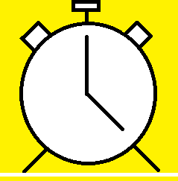
A&J’s Clockwork
By Juan Rodriguez, Johnson Dinh, and Adrian Debraga
Android Alarm System

Slide 2
Concept and Design
App Consists of alarm system, StopWatch, Timer, and Temperature Sensor
Designed to give users ease of access to anything time related in a simple formfactor
Alarm systems Benefit those who have to deal with time constraints
Local temperature readings would operate through the use of hardware element

Slide 3
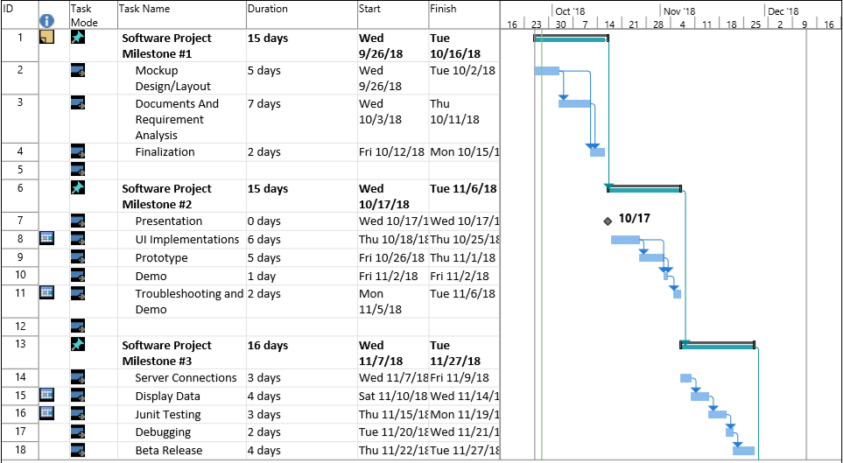
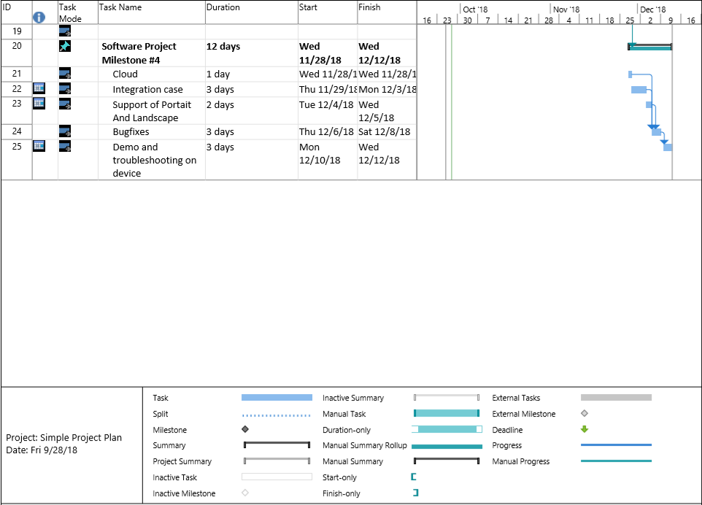
Gantt Chart Schedule

Slide 4
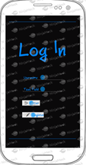
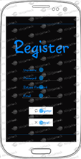
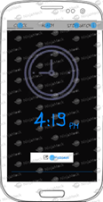
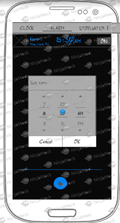
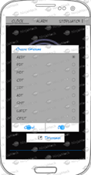
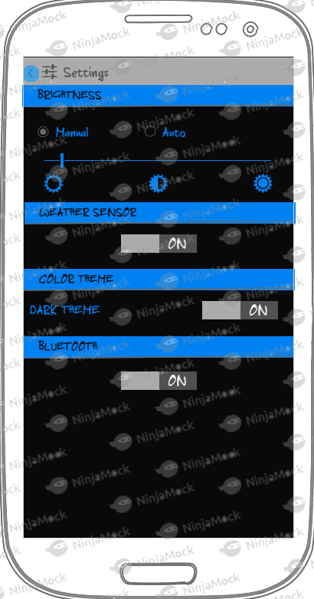
Mock UI

Slide 5
Final Product
All Functionality in working order
No bugs prevalent
Communication with database operational
Ready for hardware inclusion next semester

Slide 6
Test Plan
Check Whether user Authentication works as intended
Determine whether temperature can be displayed through app and communicate with database
Make sure app does not crash during operation
Check Pages for full functionality
Check if a sound or vibration would emit when alarm settings are met

Slide 7
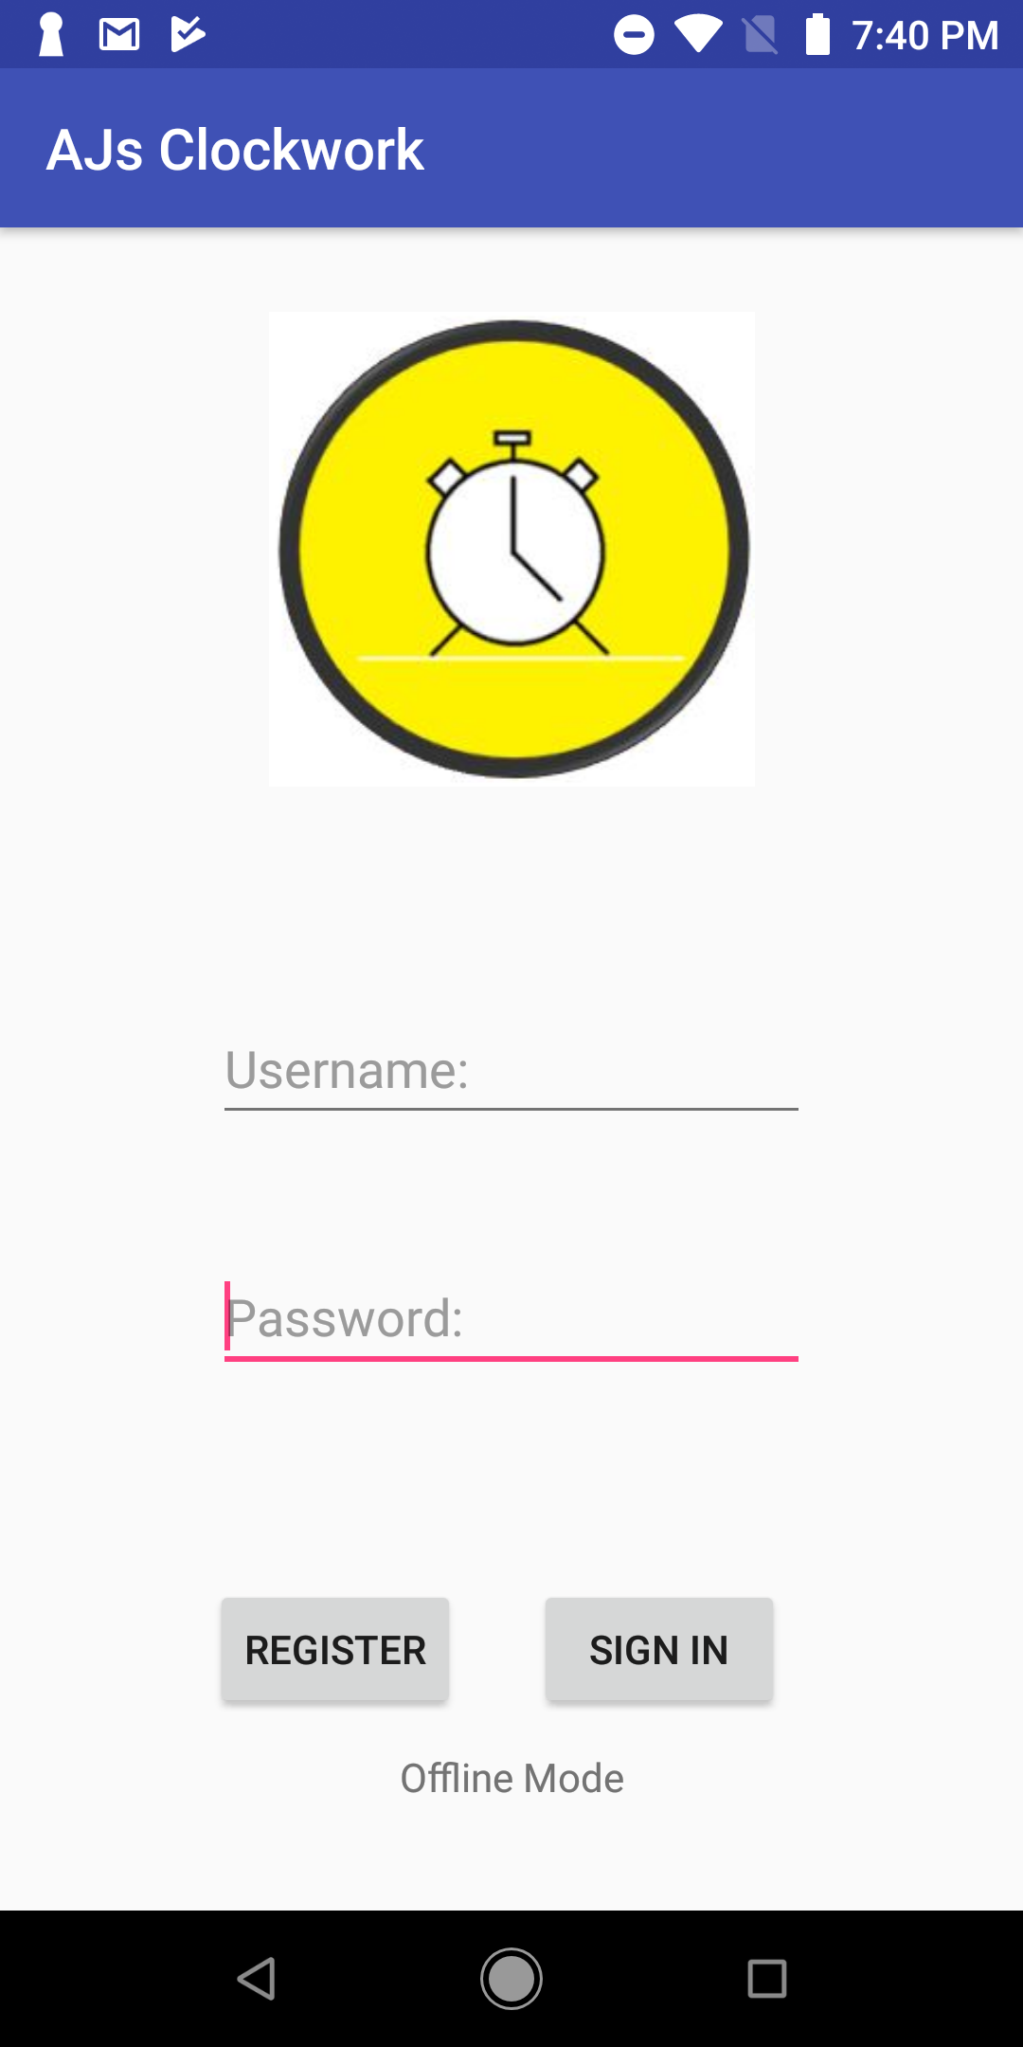
Demonstration
Demo of code and design displayed through the use of Mobizen as it is connected to an android smartphone

Slide 8
Plans for Future
Allow users the choice of adding multiple alarms at once
Implementing clock image that works in real time
Add Shared Preferences for Clock, Alarm, and Timer
More language options (spanish, German etc.)
Customization of colors and fonts throughout app
Implement hardware functionality

Slide 9
Contribution Towards Project
Juan Rodriguez - Concept, SRS, PowerPoint, Intent Functionality, Database Authentication, Layout Designs, Settings Page
Johnson Dinh - Concept, Gantt Chart, App Icon, Launcher Screen, Login/Registration Page, Read/Write Temperature Readings to Database, Layout Designs
Adrian DeBraga - Mock UI design, Home Screen, Alarm Screen, Stopwatch/Timer Screen, Tab Fragments, Full Functionality for Clock, Alarm, and Timer

Slide 10
Github
https://github.com/JuanRodriguez19/CENG319-FinalAppProject

